Slide 1
LA GALENICA CONTINUA ONLINE
Vaccini Covid-19: caratteristiche dei principi attivi e relativi meccanismi d’azione
Prof. Raffaele De Francesco

Slide 2
COVID-19 and the Current Health Crisis
First case of COVID 19 identified in Wuhan, China in December 2019
>100 million reported cased globally, >2million deaths
Recent dramatic increases globally
Serologic studies indicate we are nowhere near herd immunity thresholds
Treatments are being identified but have limitations
Steroids, monoclonal cocktails and hyperimmune plasma, antivirals
The only way to return to normal lives may be with safe and efficacious vaccines
Notes:
Consensus among experts is that only an effective COVID-19 vaccine will end the pandemic

Slide 3
Vaccine platforms
Classic vaccines
Nucleic acid-based or genetic vaccines
Nucleic acid (or genetic) vaccines are a new approach to immunization and immunotherapy in which, rather than a live or inactivated organism (or a subunit thereof), one or more genes that encode proteins of the pathogen are delivered.
Notes:
Gene vaccines are a new approach to immunization and immunotherapy in which, rather than a live or inactivated organism (or a subunit thereof), one or more genes that encode proteins of the pathogen are delivered.

Slide 4
PROs/CONs of nuclei acid vaccines:
DEVELOPMENT SPEED
Can be developed based on sequence information alone
The availability of coding sequences for viral protein(s) suffices to start vaccine development, rather than having to depend on the ability to culture the virus or engineered recombinant proteins
Can be adatpted quickly if/when new viral variant emerge
QUALITY OF IMMUNE RESPONSE
Protein antigens are synthesized by our own cells
better mimick of viral infection
ability to stimulate both the humoral and cellular arms of the adaptive immune system
Further reading: https://www.nature.com/articles/s41563-020-0746-0
Notes:
CONS: nuclei acids do not cross membranes, need for delivery

Slide 5
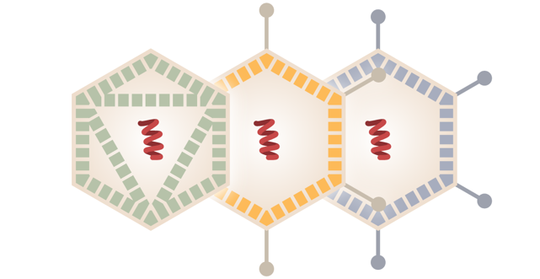
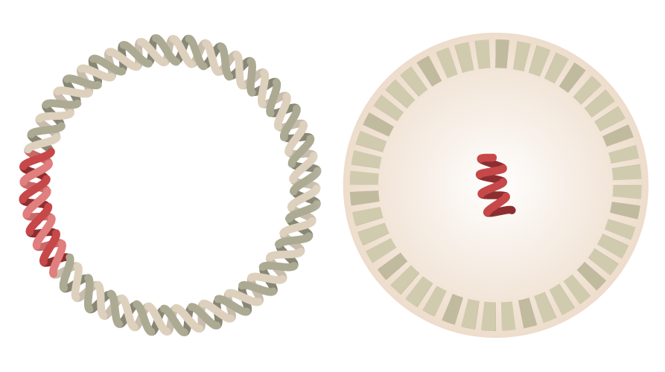
PROs/CONs of nuclei acid vaccines:
Viral vectors
DNA
mRNA
NEED FOR A DELIVERY SYSTEM
Naked nucleic acid do not cross cell membranes
Viral vector (DNA or RNA)
Electroporation, gene guns (DNA)
Lipid nanoparticles (mRNA)
Further reading: https://www.nature.com/articles/s41563-020-0746-0
Notes:
CONS: nuclei acids do not cross membranes, need for delivery

Slide 6
How mRNA/LNP Vaccine Works
Notes:
Gene vaccines are a new approach to immunization and immunotherapy in which, rather than a live or inactivated organism (or a subunit thereof), one or more genes that encode proteins of the pathogen are delivered.

Slide 7
mRNA: the active ingredient
RNA modification: use of ψ-uridine reduces innate sensing promoting expression
Notes:
Gene vaccines are a new approach to immunization and immunotherapy in which, rather than a live or inactivated organism (or a subunit thereof), one or more genes that encode proteins of the pathogen are delivered.

Slide 8
The active ingredient: Comirnaty® vs Moderna
 | Comirnaty® | Moderna
5’-CAP; Optimized UTR; PolyA | ✓ | ✓
Coding Sequence | Full Length Spike | Full Length Spike
Pre-fusion stabilized | ✓ | ✓
Codon optimization | ✓ | -
RNA modification | M1-ψ-uridine | M1-ψ-uridine
Notes:
Gene vaccines are a new approach to immunization and immunotherapy in which, rather than a live or inactivated organism (or a subunit thereof), one or more genes that encode proteins of the pathogen are delivered.

Slide 9
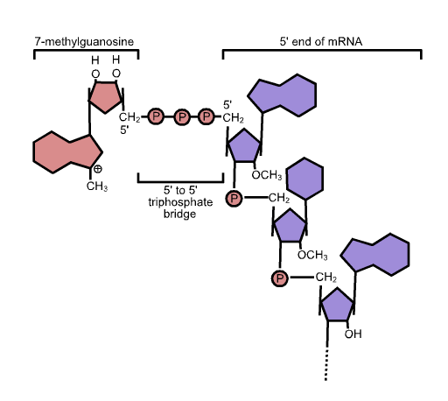
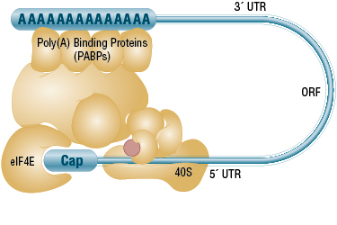
The 5’-CAP (7-methylguanylate), UTRs and polyA are critical for the formation of a translation initiation complex
Proprietary 7-methylG analogues can be used to increase translation efficiency
RNA can be efficiently synthesized in vitro (by in vitro transcription, IVT) with prokaryotic phage polymerases, such as T7
The cap and poly(A) tail structures can be added during or after the synthesis by enzymatic reactions with capping enzymes and Poly(A) Polymerase
5’-CAP also protects from innate immune sensing (RIG-I)
https://international.neb.com/tools-and-resources/feature-articles/minding-your-caps-and-tails
Notes:
Gene vaccines are a new approach to immunization and immunotherapy in which, rather than a live or inactivated organism (or a subunit thereof), one or more genes that encode proteins of the pathogen are delivered.

Slide 10
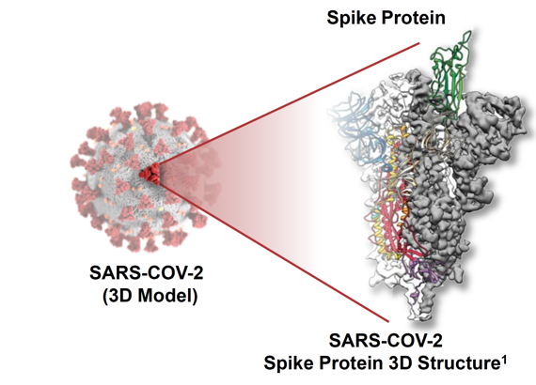
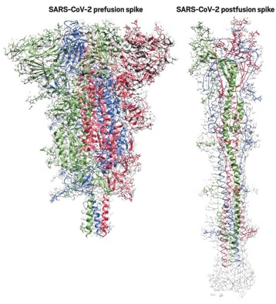
Comirnaty® and Moderna vaccines encode for full-length «pre-fusion stabilized» SARS-CoV Spike
Pro-Pro
https://cen.acs.org/pharmaceuticals/vaccines/tiny-tweak-behind-COVID-19/98/i38
Prefusion-stabilized viral glycoproteins are superior immunogens to their wild-type counterparts
These variants contain two consecutive proline substitutions in the S2 subunit in a turn between the central helix and heptad repeat 1 (HR1) that must transition to a single, elongated α helix in the postfusion conformation
https://www.pnas.org/content/114/35/E7348.long

Slide 11
Comirnaty® (but not Moderna) Spike coding sequence is «codon optimized»
Different organisms exhibit bias towards use of certain codons over others for the same amino acid
Using different codons can impact protein expression significantly
In Comirnaty® (but not in Moderna) the codon usage has been otpimized in consideration of the most abundant tRNAs in human cells
Changing the RNA – but not the protein sequence – may also decrease recognition of viral RNA by immune innate sensors (PRRs, e.g. TLRs, PKR, OAS/RNaseL …)

Slide 12
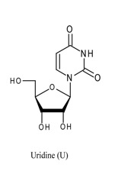
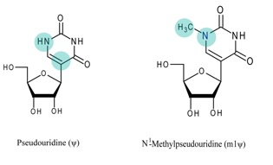
Comirnaty® and Moderna vaccines incorporate 1-Me- ψ-uridine in place of uridine
RNA is pro-inflammatory (and inherently unstable)
1-Me- ψ-uridine innate immune sensing
Reduced recognition by TLRs, PKR, OAS/RNase L…
Increased stability toward hydrolytic degradation
→ Enhanced protein expression

Slide 13
Comirnaty® and Moderna vaccine: outstanding questions
Is the second dose necessary? Can it be delayed?
Are the vaccines active on the new viral variants?
Do the vaccines protect from SARS-CoV-2 infection or only from COVID-19 disease?
Notes:
Gene vaccines are a new approach to immunization and immunotherapy in which, rather than a live or inactivated organism (or a subunit thereof), one or more genes that encode proteins of the pathogen are delivered.

Slide 14
Is a booster dose necessary?
0
 | Comirnaty® | Moderna
Dose | 30 µg | 100 µg
Prime-Boost interval | 21 days | 28 days
A booster dose favors:
Increased levels of antibodies
Increased affinity of antibodies (affinity maturation)
Increased duration of protection (stimulation of memory cells)
Notes:
Gene vaccines are a new approach to immunization and immunotherapy in which, rather than a live or inactivated organism (or a subunit thereof), one or more genes that encode proteins of the pathogen are delivered.

Slide 15
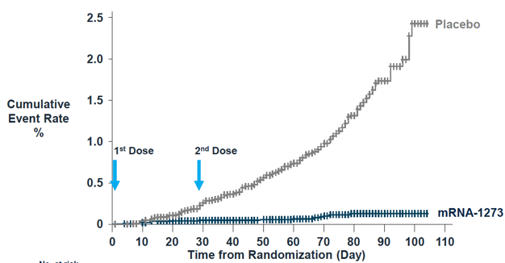
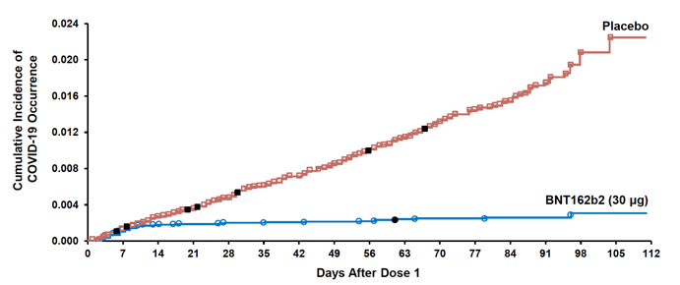
Comirnaty® and Moderna vaccines provide some level of protection after 1st dose
Moderna
Comirnaty®
2nd Dose
Maximal protection observed with prime-boost regimen
Phase I/II trial clearly indicate higher antibody titers with prime-boost
Phase III trials not designed to evaluate single-dose regimen
Maximal protection observed with prime-boost regimen
No data on duration of protection for single dose – may be too short
Longer prime-boost intervals not explored in Phase III trials
Notes:
Gene vaccines are a new approach to immunization and immunotherapy in which, rather than a live or inactivated organism (or a subunit thereof), one or more genes that encode proteins of the pathogen are delivered.

Slide 16
Emerging viral variants
UK variant
South African
variant
Brasilian
variant
Notes:
Gene vaccines are a new approach to immunization and immunotherapy in which, rather than a live or inactivated organism (or a subunit thereof), one or more genes that encode proteins of the pathogen are delivered.

Slide 17
Laboratory tests show that B.1.1.7 (UK variant) is neutralized by antibodies iduced by Comirnaty® and Moderna vaccines
However reduced neutralization was measured against the mutations present in B.1.351 South Africa variant
New vaccine version can be developed in 6 weeks
Notes:
Gene vaccines are a new approach to immunization and immunotherapy in which, rather than a live or inactivated organism (or a subunit thereof), one or more genes that encode proteins of the pathogen are delivered.

Slide 18
Summary of EU vaccines (emergency authorized or forthcoming)
 |  | mRNA vaccine |  |  | Adenoviral vector vaccines |  |  | Recombinant protein+Adjuvants
 |  |  |  |  | Ad-scimpanzè | Ad-umano | Ad-gorilla
 |  | Moderna | Pfizer | CureVac | AstraZeneca | J&J | ReiThera | Novavax | Sanofi
a. | Neutralizing Antibodies | Y | Y | Y | Y | Y | Y | Y | Y
b. | Preclinical Efficacy
 | b1. Sterilizing immunity | N | Y* | Y* | N | Y | ND | Y* | Y
 | b2. Disease protection | Y | Y | Y | Y | Y | ND | Y | Y
c. | Clinical Efficacy
 | c1. Sterilizing Immunity | ND | ND | ND | ND | ND | ND | ND | ND
 | c2. Disease Protection | 95% | 95% | ND | 70% | ND | ND | ND | ND
d. | Immunological Memory | ND | ND | ND | ND | ND | ND | ND | ND
*high dose
Do COVID-19 vaccines protect from SARS-CoV-2 infection?
Sterilizing immunity demonstrated for some vaccines in non-human primates
No clinical data yet (the jury is still out)
Notes:
Gene vaccines are a new approach to immunization and immunotherapy in which, rather than a live or inactivated organism (or a subunit thereof), one or more genes that encode proteins of the pathogen are delivered.

