Slide 1
LA GALENICA CONTINUA ONLINE
Nanoparticelle e loro funzioni
Francesca Selmin
Dip. Scienze Farmaceutiche
Università degli Studi di Milano

Slide 2
Nucleic acid-based vaccines
To mimic a viral infection to express vaccine antigens in situ, resulting in induction of both humoral and cytotoxic T cell responses.
Susceptibility to RNAses
Low overall efficacy:
  Too large (300–5,000 kDa)
  Negative charged to passively cross the cell membrane
naked mRNA
Biotechnology Advances | VOL 40 | May–June 2020 | 107534

Slide 3
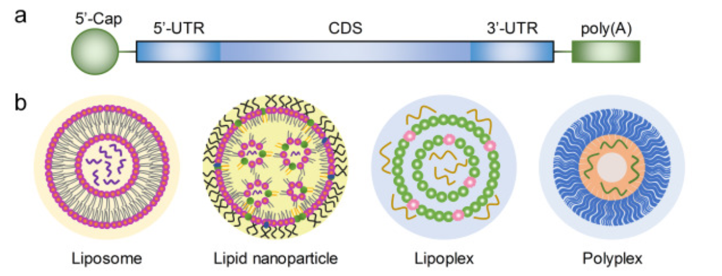
Nucleic acid-based vaccines
Physical delivery of naked mRNA
  Electroporation
  Gene gun
  Sonophoresis
  Microneedles
Protamine-formulated delivery system
Cationic lipid-based delivery system
Polymer-Based Delivery System
Int J Mol Sci| VOL 21 | 2020 | 6582
Notes:
As such, the mRNA delivery field has focused on the discovery and development of methods and materials that can transport RNA into cells, benefiting from extensive prior research into non-viral delivery of small interfering RNA (siRNA), recently reviewed elsewhere.125, 126

Slide 4
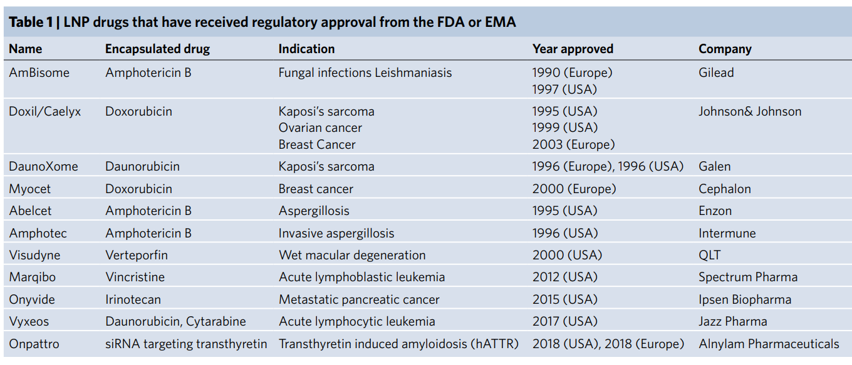
LNP approved by the FDA or EMA
Nature Nanotechnology | VOL 14 | December 2019 | 1084–1087

Slide 5
Pre-clinical development
 LNP siRNA system
Onpattro ®
Target
efficient encapsulation of siRNA,
low surface charge to avoid rapid clearage in circulation,
diameter < 100 nm,
to deliver encapsulated siRNA to the cytoplasm of hepatocytes in vivo,
following IV administration.
Nature Nanotechnology | VOL 14 | December 2019 | 1084–1087

Slide 6
Pre-clinical development
 LNP siRNA system
Onpattro ®
Ionizable cationic lipids (pKa ~ 6.5)
@ acidic pH → positively charged
@ physiological pH → neutral
Targets
efficient encapsulation of siRNA,
low surface charge,
diameter < 100 nm,
to deliver encapsulated siRNA to the cytoplasm of hepatocytes in vivo after IV administration.
PEG-lipids with relatively short C₁₄ acyl chains
In the presence of a lipid sink (e.g. lipoprotein in plasma), PEG-lipids can exchange out of the LNP, generating unshielded particles that can engage with target cells to enable uptake
Nature Nanotechnology | VOL 14 | December 2019 | 1084–1087

Slide 7
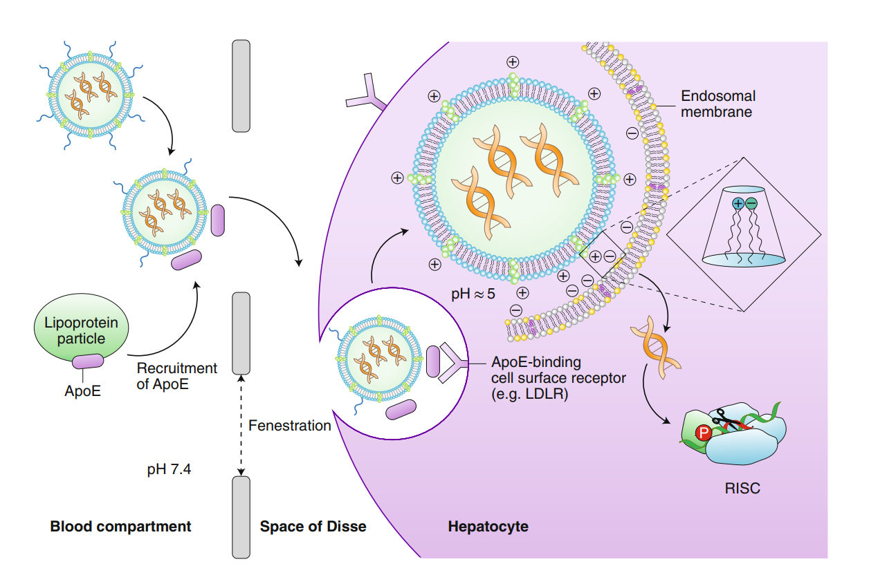
Pre-clinical development
 LNP siRNA system
Nature Nanotechnology | VOL 14 | December 2019 | 1084–1087

Slide 8
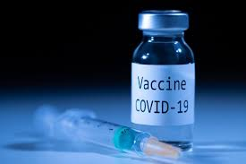
COVID-19 vaccine
 LNP
Functional lipids
Ionizable aminolipid
PEGylated lipid
Structural lipids
Phospholipids → formation of a bilayer structure
Cholesterol → stabilizer

Slide 9
COVID-19 Vaccines
 LNP
 | Compound | Comirnaty® | Moderna
Functional | Ionizable aminolipid | ALC-0315 | SM-102
 | PEGylated lipid | ALC-0159 | PEG2000-DMG
Structural | Phospholipids | DSPC | DSPC
 | Stabilizer | Cholesterol | Cholesterol
COVID-19 mRNA vaccine (nucleoside-modified) Procedure No. EMEA/H/C/005735/0000
COVID-19 mRNA Vaccine (nucleoside-modified) Procedure No. EMEA/H/C/005791/0000

Slide 10
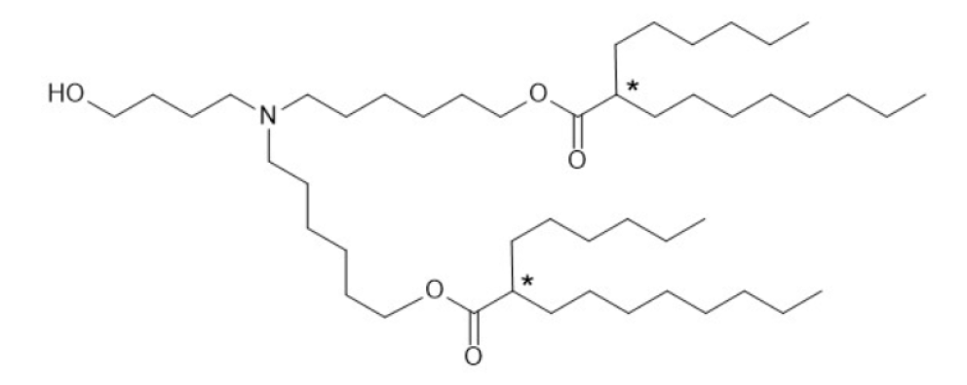
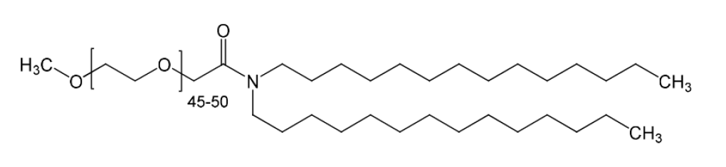
ALC-0135
((4-hydroxybutyl)azanediyl)bis(hexane-6,1-diyl)bis(2-hexyldecanoate)
SM-102
Heptadecan-9-yl 8-((2-hydroxyethyl) (6-oxo-6-(undecyloxy) hexyl) amino)octanoate
Compound | Comirnaty® | Moderna
Ionizable aminolipid | ALC-0315 | SM-102
PEGylated lipid | ALC-0159 | PEG2000-DMG
ALC_0159
PEGylated lipid, 2 [(polyethylene glycol)-2000]-N,N-ditetradecylacetamide
PEG2000-DMG
1,2-Dimyristoyl-rac-glycero-3-methylpolyoxyethylene
COVID-19 mRNA vaccine (nucleoside-modified) Procedure No. EMEA/H/C/005735/0000
COVID-19 mRNA Vaccine (nucleoside-modified) Procedure No. EMEA/H/C/005791/0000

Slide 11
COVID-19 vaccine
 LNP
Functional lipids
Ionizable aminolipid
PEGylated lipid
Structural lipids
Phospholipids → formation of a bilayer structure
Cholesterol → stabilizer
After IM administration, a transient local inflammation drives recruitment of neutrophils and antigen presenting cells (APCs) to the site of delivery. Recruited APCs can uptake LNP and subsequently migrate to the local draining lymph nodes where T cell priming occurs.
COVID-19 mRNA vaccine (nucleoside-modified) Procedure No. EMEA/H/C/005735/0000
COVID-19 mRNA Vaccine (nucleoside-modified) Procedure No. EMEA/H/C/005791/0000

Slide 12
Grazie per l’attenzione

